Slide 1

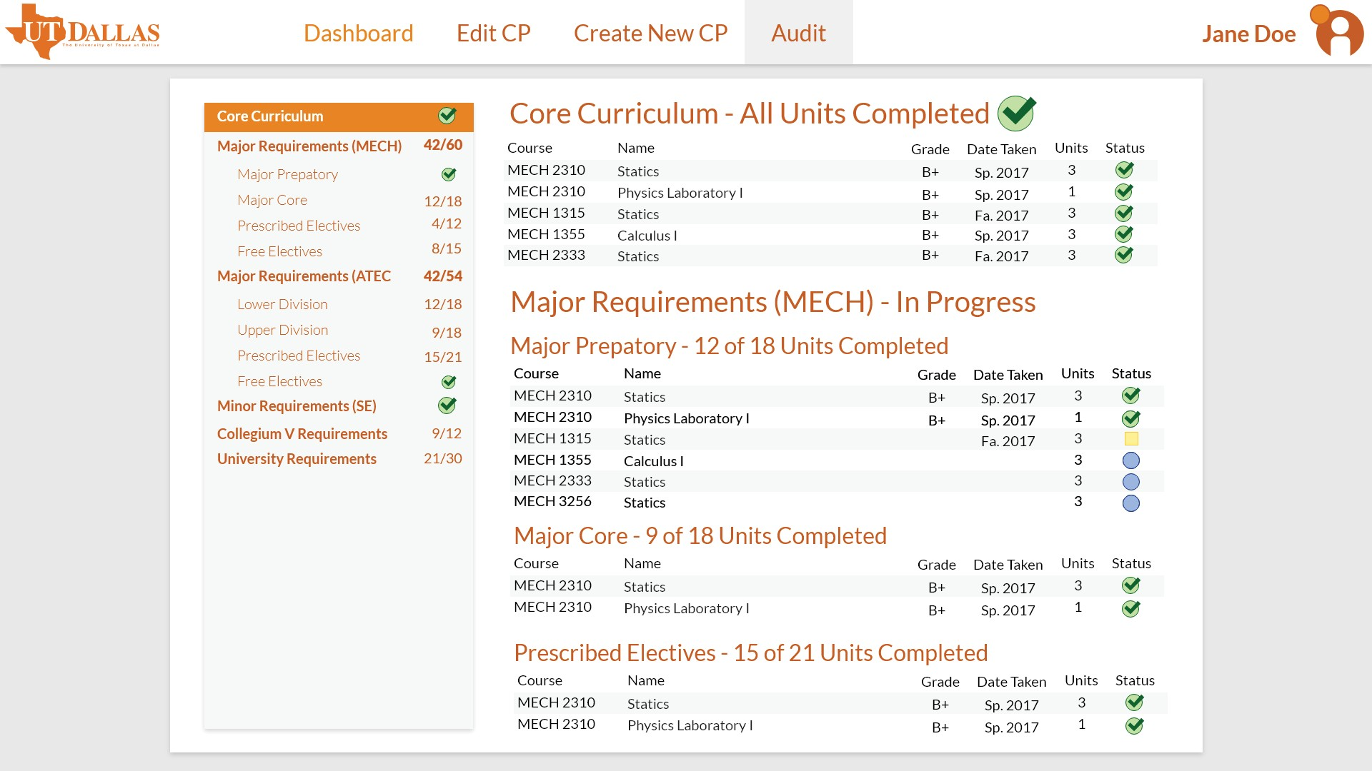




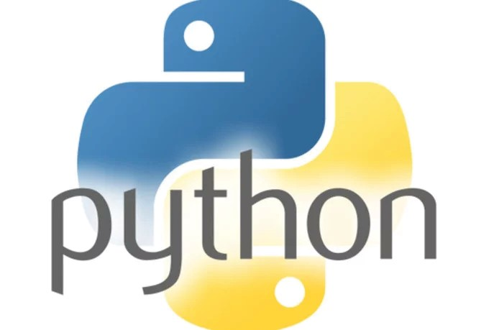
ramifai
CS 4485 / Fall 2019
Department of Computer Science Erik Jonsson School of Engineering &
Computer Science The University of Texas at Dallas Richardson, TX 75080, USA
Degree Planning Tool Using AI
Technical Team
UX/UI Team
Marcus Gonzalez
mjg140130@utdallas.edu
Hannah Barnes
hkb160130@utdallas.edu
Faculty Advisors
Dr. Jim L. Grifﬁn
Dr. Gopal Gupta Karen Doore
James J. Grifﬁn - Founder of RamifAI
James.Grifﬁn@utdallas.edu
Jonathan Sayre - Technical Lead
jds028000@utdallas.edu
Rudy Cantu
rjc108020@utdallas.edu
Christopher Lorenzo
cxl127930@utdallas.edu
Abhishaike Mahajan
akm150130@utdallas.edu
Fletcher Berry
fjb150030@utdallas.edu
Joshua Mills
Cassini Nazir
jwm150730@utdallas.edu
Special Thanks to Dr. Redlinger, James Michalek, Dr. Murphy, and Jennifer McDowell
Abstract
It is incredibly difﬁcult for students to graduate on-time despite their best efforts. Degree plans are very complex and missing a class or taking the wrong one can have a devastating ripple effect, completely derailing a student’s graduation. Currently, there is no product that solves this problem effectively. While degree planning software does exist, it puts all the onus on the student to select the correct classes. We decided to take a different approach.
The tool we developed creates an optimal path to graduation for a student using artiﬁcial intelligence. This individualized plan can then be modiﬁed through the web application, allowing a student full control over their college career. All edits are checked by our algorithms, ensuring students are making valid changes to their degree plan.
Keywords: AI, Degree Planning, UI/UX, FullStack
“Create Course Plan”
“Student Dashboard”
“Degree Audit”
Architecture
Front-End
The front-end was built using the Bootstrap framework and was inspired by Material Design. It uses Jinja2 templates to dynamically populate the HTML. Uses input sanitization to prevent SQL injection.
Server
The server is created in Python and uses the Flask library to deﬁne RESTful APIs that can be called by other modules. Uses Redis for sessions which allows for server-side transmissions of private data.
Back-end
The back-end is coded in Python and contains the business logic of the tool.
RamifAI Database
The MySQL database is conﬁgured using SSL and optimized to work with constraint-based scheduling algorithms.
School Database
The tool is compatible with UTD’s conﬁguration of PeopleSoft Campus Solutions.
Front-end
“Edit Course Plan”
WINNER
Server
Features
Creates a highly optimized course plan based on speciﬁed majors and minors
Suggests relevant electives by running machine learning modules on past student data
Historical extrapolation detects if classes are only offered in the Fall or Spring
Automatic requirement checking ensures students are planning a valid schedule
Allows students to modify and save multiple course plans
Integrates with UTD’s databases and student information system
Toggleable light and dark themes work with any university palette
Intuitive UI developed with feedback from multiple students and advisors
Adjusts suggestions based on classes already taken and current course catalog
RamifAI Database
School Database
Back-end
Student Impact
Students have 24/7 access, allowing them to get advising without waiting in long lines.
By lowering the chance of taking classes that won’t count towards graduation, students are saving time and money.
Future Plans
A beta version of this tool is planned to be tested in NSM and JSOM over this summer. The eventual goal is to implement it university wide to help both students and advisors. To increase the tool’s adaption, a mobile application is going to be developed. There are also plans to develop functionality for administrators that would suggest what courses should be offered each semester based on the aggregate data of student course plans.
Students now have a better understanding of their academic degree plan and how decisions such as switching majors affect their path to graduation.

